Slide 1

Web Development & Design Foundations with HTML5
Tenth Edition
Chapter 5
Web Design
Copyright © 2021, 2019, 2017 Pearson Education, Inc. All Rights Reserved

Slide 2
Learning Outcomes (1 of 2)
In this chapter, you will learn how to ...
Describe the most common types of website organization
Describe principles of visual design
Design for your target audience
Create clear, easy-to-use navigation
Improve the readability of the text on your web pages
Use graphics appropriately on web pages

Slide 3
Learning Outcomes (2 of 2)
Apply the concept of universal design to web pages
Describe web page layout design techniques
Describe the concept of responsive web design
Apply best practices of web design

Slide 4

Overall Design Is Related to the Site Purpose (1 of 2)
Figure 5.1 The compelling graphic draws you in

Slide 5
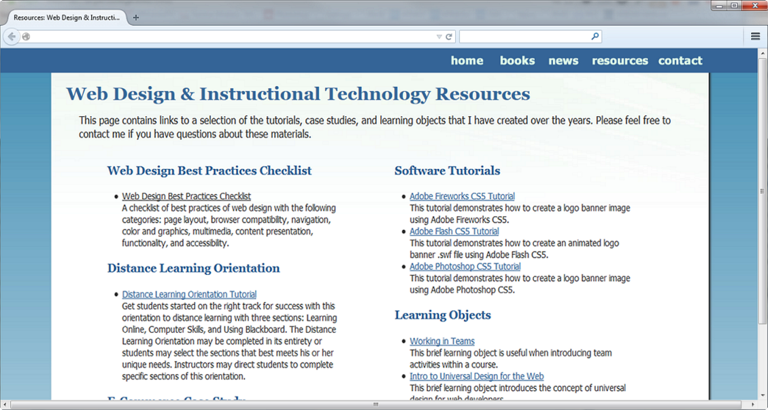
Overall Design Is Related to the Site Purpose (2 of 2)
Consider the target audience of these sites.
Figure 5.2 This text-intensive web page offers numerous choices

Slide 6
Website Organization
Hierarchical
Linear
Random (sometimes called Web Organization)

Slide 7
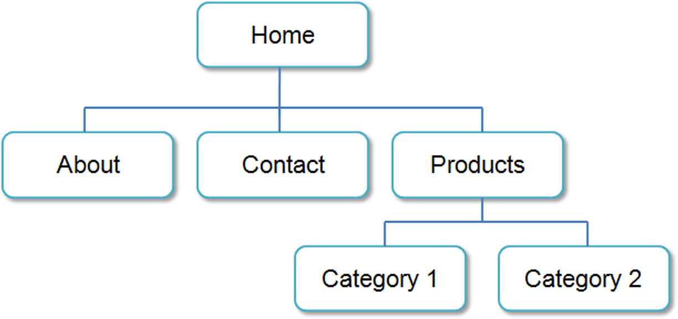
Hierarchical Organization
A clearly defined home page
Navigation links to major site sections
Often used for commercial and corporate websites
Figure 5.3 Hierarchical site organization

Slide 8
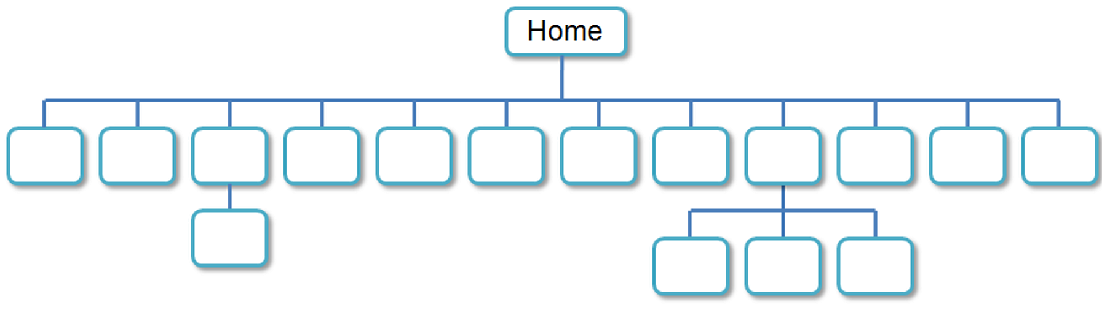
Hierarchical & Shallow (1 of 2)
Figure 5.4 This site design uses a shallow hierarchy

Slide 9
Hierarchical & Shallow (2 of 2)
Be careful that the organization is not too shallow.
Too many choices → a confusing and less usable web site
Information Chunking
Be aware of the number of major navigation links
Try to group navigation links visually into groups with no more than about four links.

Slide 10
Hierarchical & Deep
Be careful that the organization is not too deep.
This results in many “clicks” needed to drill down to the needed page.
User Interface “Three Click Rule”
A web page visitor should be able to get from any page on your site to any other page on your site with a maximum of three hyperlinks.

Slide 11
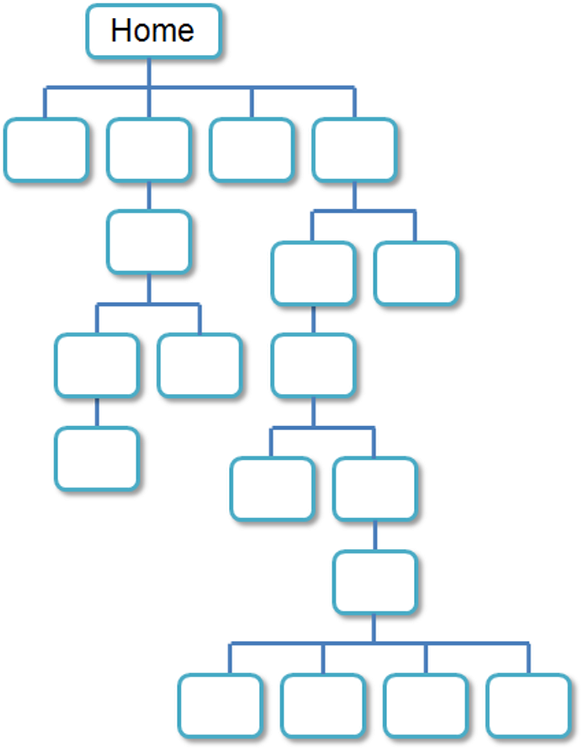
Figure 5.5 This site design uses a deep hierarchy

Slide 12
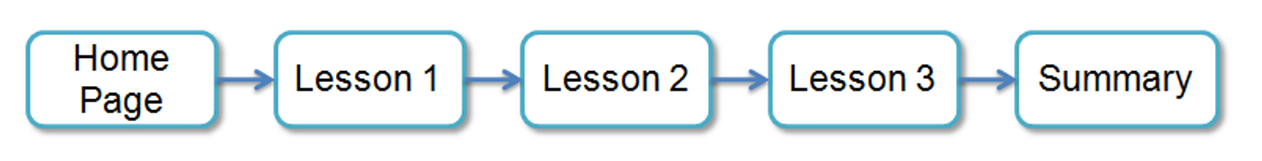
Linear Organization
A series of pages that provide a tutorial, tour, or presentation.
Sequential viewing
Figure 5.6 Linear site organization

Slide 13
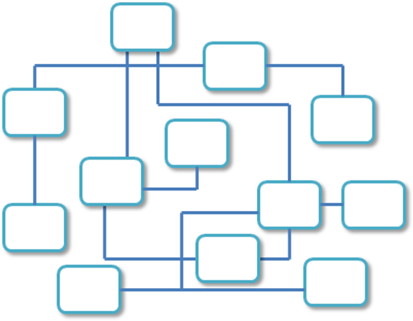
Random Organization
Sometimes called “Web” Organization
Usually there is no clear path through the site
May be used with artistic or concept sites
Not typically used for commercial sites.
Figure 5.7 Random site organization

Slide 14
Design Principles
Repetition
Repeat visual elements throughout design
Contrast
Add visual excitement and draw attention
Proximity
Group related items
Alignment
Align elements to create visual unity

Slide 15
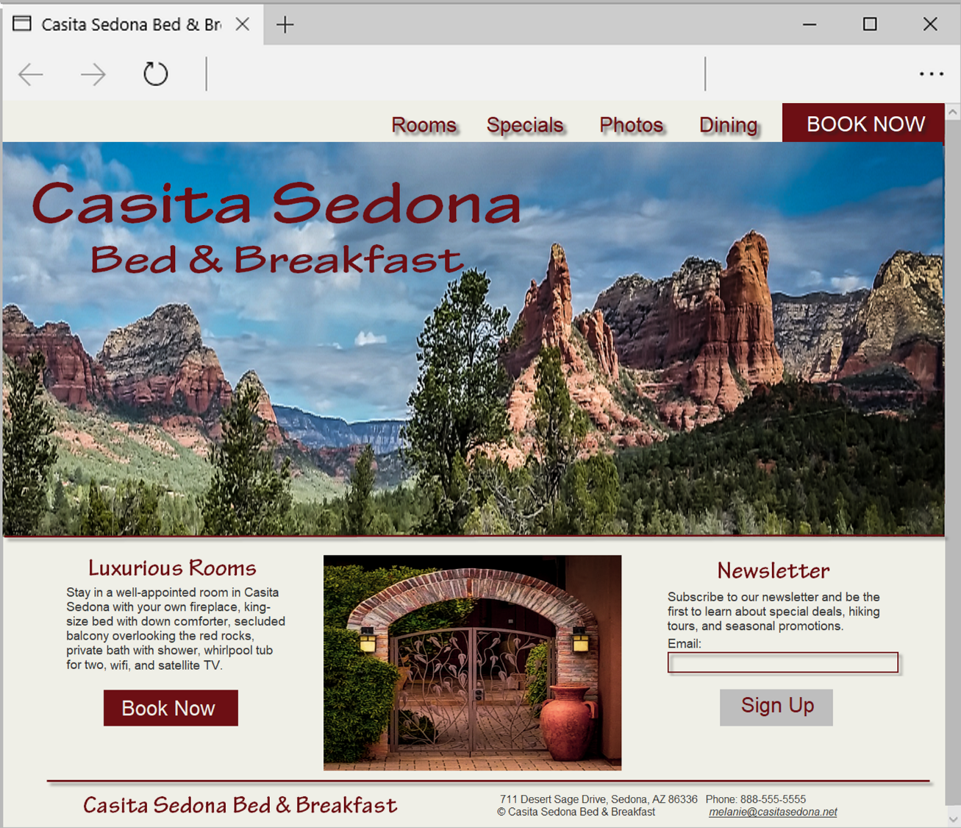
Figure 5.8 The design principles of repetition, contrast, proximity, and alignment are applied on this web page.

Slide 16
Design to Provide for Accessibility
“The power of the Web is in its universality. Access by everyone regardless of disability is an essential aspect.” – Tim Berners-Lee
Who benefits from increased accessibility?
A person with a physical disability
A person using a slow Internet connection
A person using an old, outdated computer
A person using a mobile phone
Legal Requirement: Section 508
Standards: WCAG 2.0, WCAG 2.1

Slide 17
Design for Accessibility (1 of 2)
Web Content Accessibility Guidelines 2.0 WCAG 2.0
https://www.w3.org/TR/WCAG21/Overview
https://www.w3.org/WAI/WCAG21/quickref/?versi ons=2.0

Slide 18
Design for Accessibility (2 of 2)
Based on Four Principles (POUR)
Perceivable Content must be Perceivable
Operable Interface components in the content must be Operable
Understandable Content and controls must be Understandable
Robust. Content should be Robust enough to work with current and future user agents, including assistive technologies

Slide 19
Writing for the Web
Avoid long blocks of text
Use bullet points
Use headings and subheadings
Use short paragraphs

Slide 20
Design “Easy to Read” Text
Use common fonts:
Arial, Helvetica, Verdana, Times New Roman
Use appropriate text size:
medium, 1em, 100%
Use strong contrast between text & background
Use columns instead of wide areas of horizontal text

Slide 21
More Text Design Considerations
Carefully choose text in hyperlinks
Avoid “click here”
Hyperlink key words or phrases, not entire sentences
Chek yur spellin (Check your spelling)

Slide 22

Color Theory
Color Theory:
the study of color and its use in design
Color Wheel
Primary Colors
Secondary Colors
Tertiary Colors
Figure 5.11 Color wheel

Slide 23
Color Schemes Based on The Color Wheel (1)
Monochromatic – shades, tints, or tones of the same color http://meyerweb.com/eric/tools/color-blend
Analogous – a main color and two colors adjacent to it on the color wheel
Complementary – two colors that are opposite each other on the color wheel

Slide 24



Color Schemes Based on The Color Wheel (1)
Figure 5.13 Monochromatic color scheme
Figure 5.15 Complementary color scheme
Figure 5.14 Analogous color scheme

Slide 25
Color Schemes Based on The Color Wheel (2)
Split Complementary – a main color, the color opposite it on the color wheel (the complement) and two colors adjacent to the complement
Triadic- three colors that are equidistant on the color wheel
Tetradic – two complementary color pairs

Slide 26



Color Schemes Based on The Color Wheel (2)
Figure 5.16 Split complementary color scheme
Figure 5.18 Tetradic color scheme
Figure 5.17 Triadic color scheme

Slide 27
Implementing a Color Scheme
Choose one color to be dominant
Use other colors in the color scheme as accent colors
headings,
subheadings
borders,
list markers, etc.
Use neutrals such as white, off-white, gray, black, or brown
Do not restrict yourself to web-safe colors
Feel free to use tints, shades, or tones of colors

Slide 28
Verify Sufficient Contrast
When you choose colors for text and background, sufficient contrast is needed so that the text is easy to read.
Use one of the following online tools to verify contrast:
http://webaim.org/resources/contrastchecker
http://snook.ca/technical/colour_contrast/colour.html
http://juicystudio.com/services/luminositycontrastratio.php

Slide 29
Color Scheme Resources
https://meyerweb.com/eric/tools/color-blend
http://paletton.com
http://www.colorsontheweb.com/colorwizard.asp
https://color.adobe.com/create
http://www.colorspire.com
http://hslpicker.com
Figure 5.11 Color wheel

Slide 30
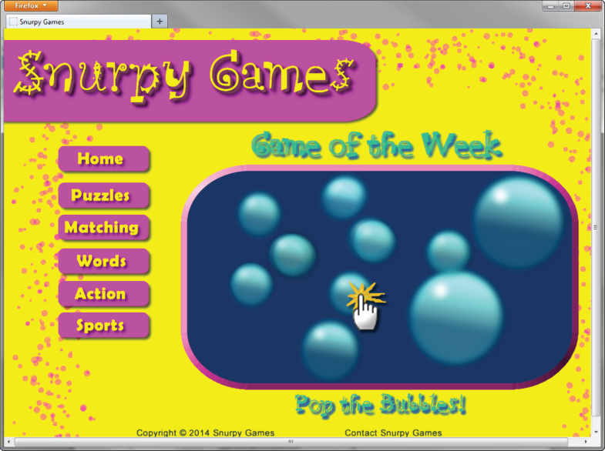
Color & Target Audience (1 of 4)
Appealing to Kids & Preteens
Figure 5.20 A web page intended to appeal to children

Slide 31
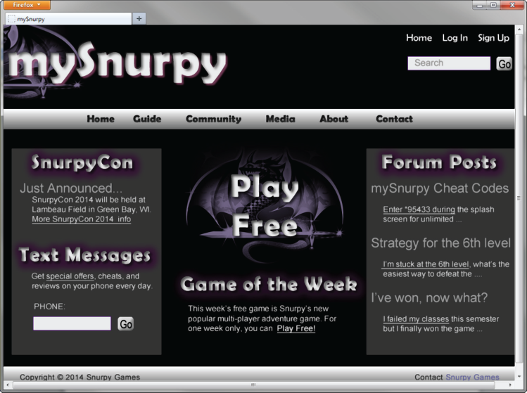
Color & Target Audience (2 of 4)
Appealing to Young Adults
Figure 5.21 A web page intended to appeal to children

Slide 32
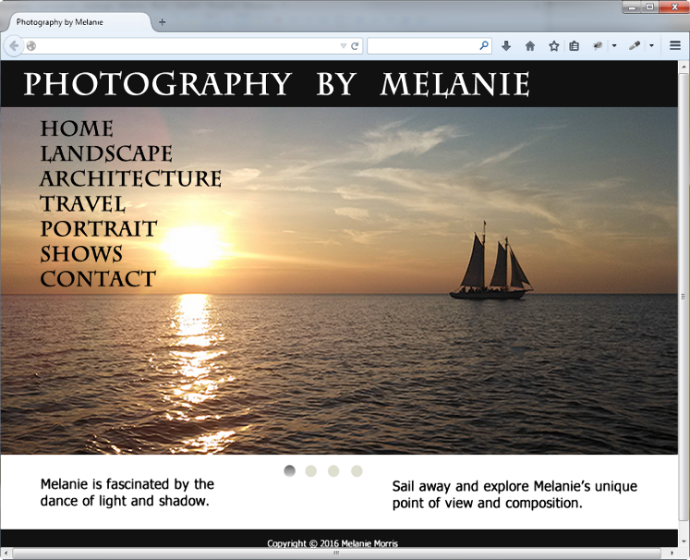
Color & Target Audience (3 of 4)
Appealing to Everyone
Figure 5.22 A compelling graphic along with white background for the content area

Slide 33
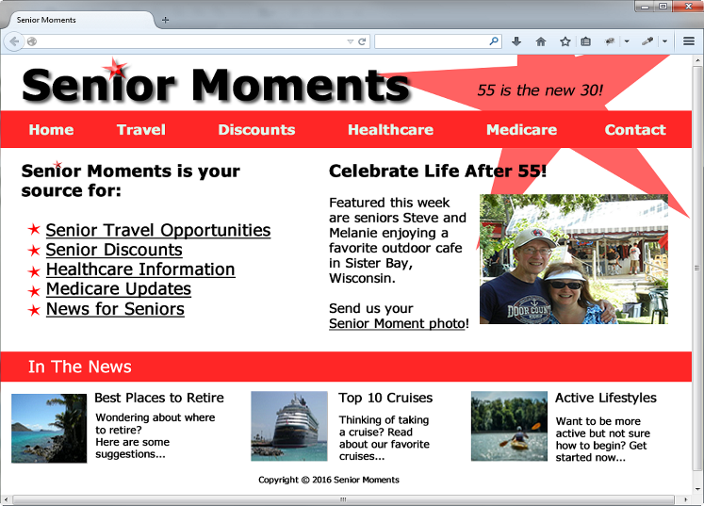
Color & Target Audience (4 of 4)
Appealing to Older Adults
Figure 5.23 A site designed specifically for the 55-and-older age
Group

Slide 34
Checkpoint
List the four basic principles of design. View the home page of your school and describe how each principle is applied.
View https://www.walmart.com, http://www.willyporter.com , and https://www.sesamestreet.org/art-maker
Describe the target audience for each site. How do their designs differ? Do the sites meet the needs of their target audiences?

Slide 35
Use of Graphics & Multimedia
File size and dimension matter
Provide for robust navigation
Antialiased/aliased text considerations
Provide alternate text
Use only necessary multimedia

Slide 36
Graphic Design Best Practices(1)
Be careful with large graphics!
Use the alt attribute to supply descriptive alternate text
Be sure your message gets across even if images are not displayed.
If using images for navigation provide plain text links at the bottom of the page.
Use animation only if it makes the page more effective and provide a text description.

Slide 37


Graphic Design Best Practices (2)
There is no requirement to limit your color choices to web safe colors.
Use anti-aliased text in images
Figure 5.24 Antialiased text
Figure 5.25 This graphic was
not antialiased: The letter “A”
has a jagged look

Slide 38

Graphic Design Best Practices (3)
Use only necessary images
Reuse images
Goal: image file size should be as small as possible with acceptable display quality
Do you really need to see a photo of my dog right now?
Sparky the Dog © Terry Felke-Morris

Slide 39
Web Page Design Browsers & Screen Resolution
Test with multiple browsers
Google Chrome, Mozilla Firefox, Microsoft Edge, Apple Safari
Test at various screen resolutions
Design to look good at various screen resolutions
Centered page content
Set to either a fixed or percentage width

Slide 40
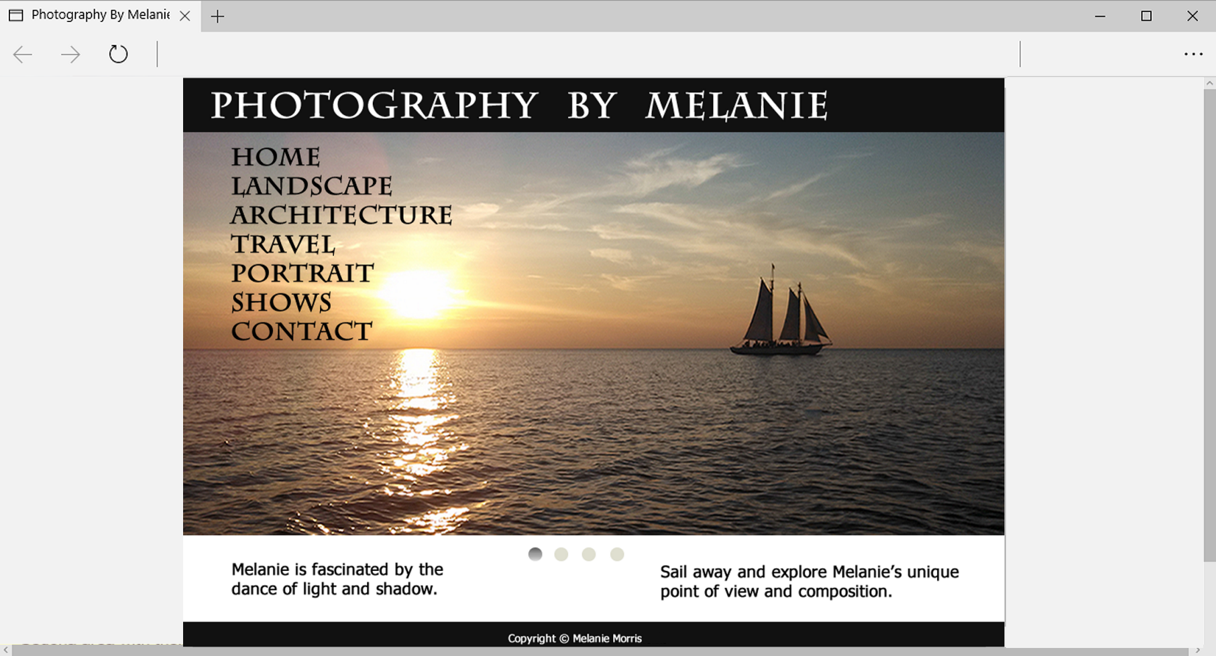
Figure 5.38 This fixed-width centered content is balanced on the page by left and right margins

Slide 41
Navigation Design
Make your site easy to navigate
Provide clearnavigation in the same location on each page
Most common – across top or down left side
Consider:
Navigation Bars
Breadcrumb Navigation
Using Graphics for Navigation
Dynamic Navigation
Site Map
Site Search Feature
“Skip to Content” Hyperlink

Slide 42
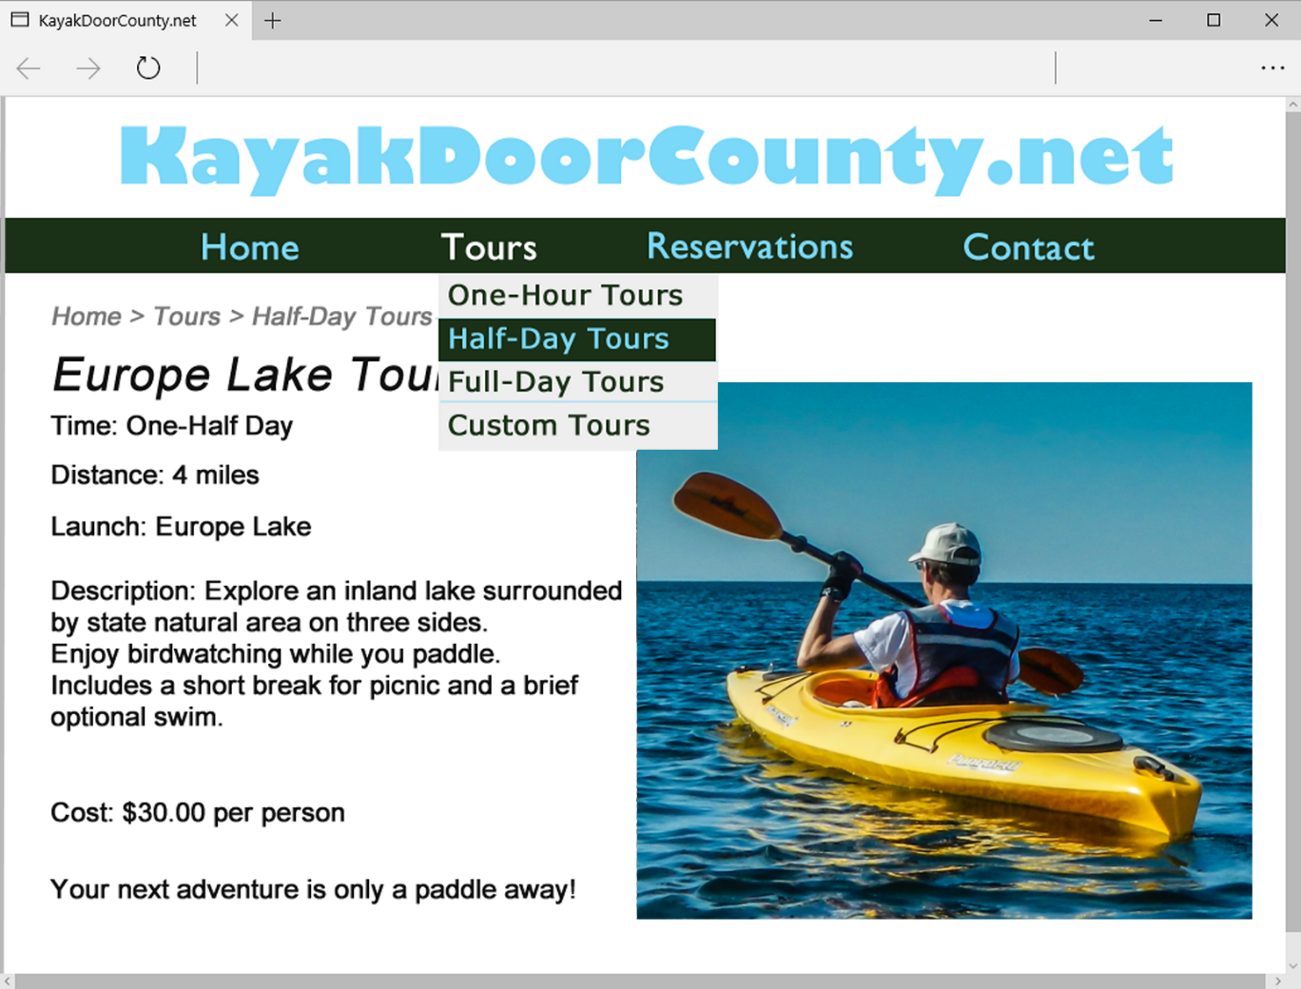
Figure 5.31 Dynamic navigation with HTML and CSS

Slide 43
Wireframe
A sketch or blueprint of a web page
Shows the structure of the basic page elements, including:
Header
Navigation
Content
Footer
Image locations

Slide 44
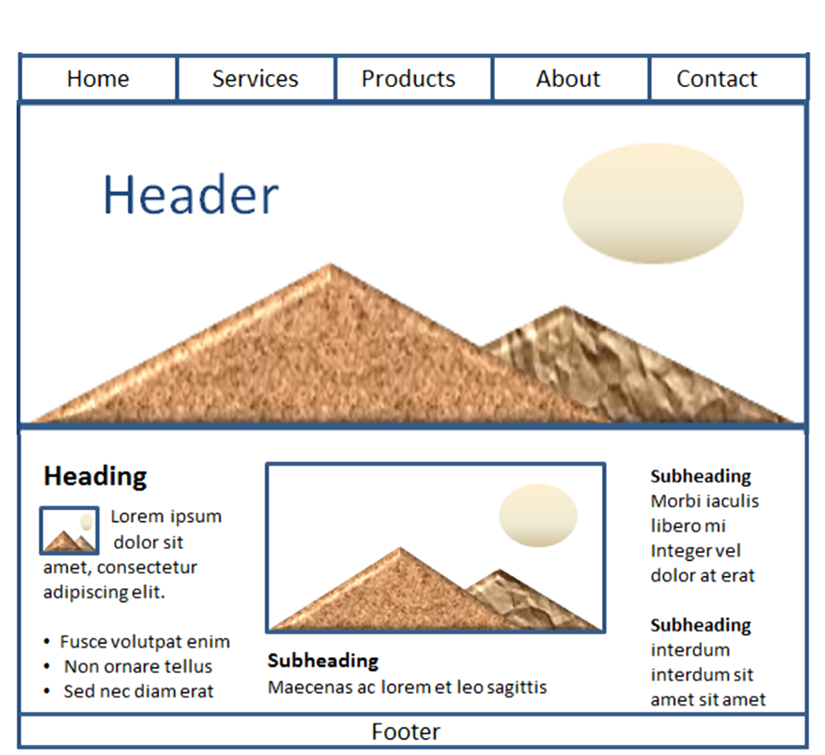
Figure 5.35 This wireframe page layout a top navigation area and a hero image

Slide 45
Web Page Design Page Layout (1)
Place the most important information "above the fold"
Use adequate "white" or blank space
Use an interesting page layout

Slide 46
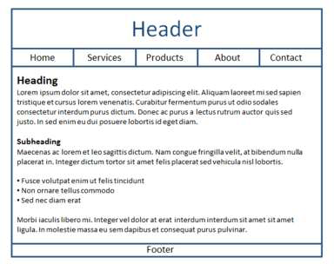
Figure 5.33 An adequate page layout
This is usable, but a little boring. See the next slide for improvements in page layout.

Slide 47
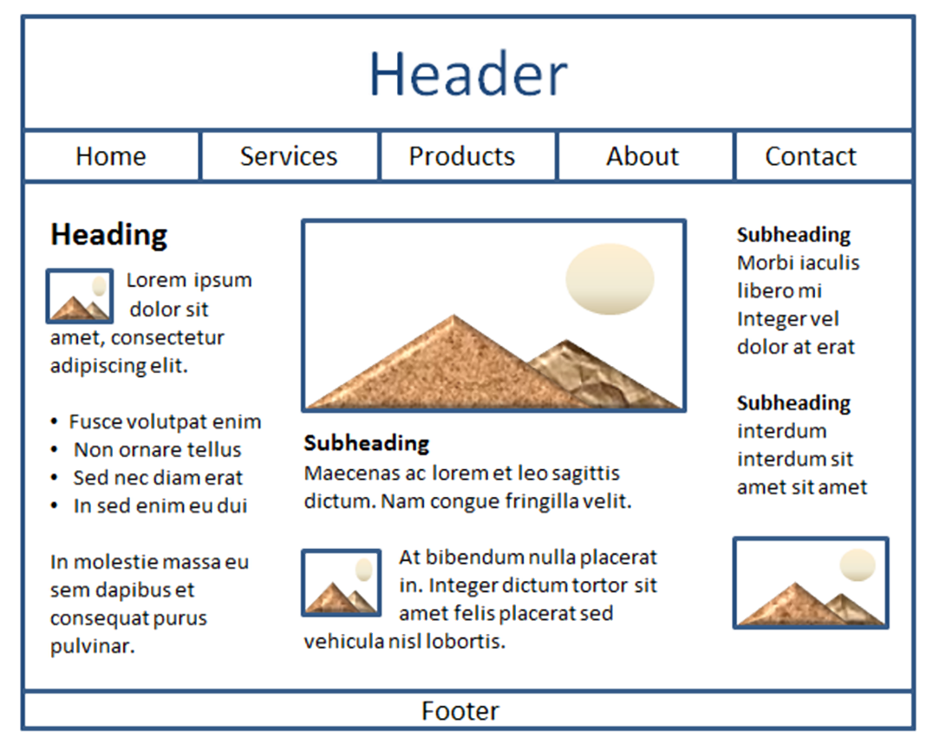
Figure 5.34 An adequate page layout
Better
Columns make the page more interesting and it’s easier to read this way.

Slide 48
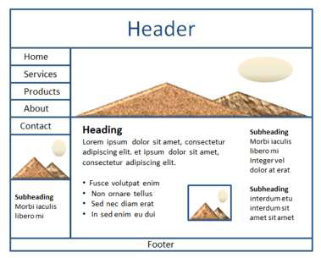
Web Page Design Page Layout (3)
Best
Figure 5.36
Columns interspersed with graphics and headings create the most interesting, easy to read page.
Figure 5.35

Slide 49
Page Layout Design Techniques (1 of 2)
Fixed Layout
AKA rigid or “ice” design
Fixed-width often at left margin
More appealing if fixed with content is centered
Figure 5.37
Figure 5.38

Slide 50
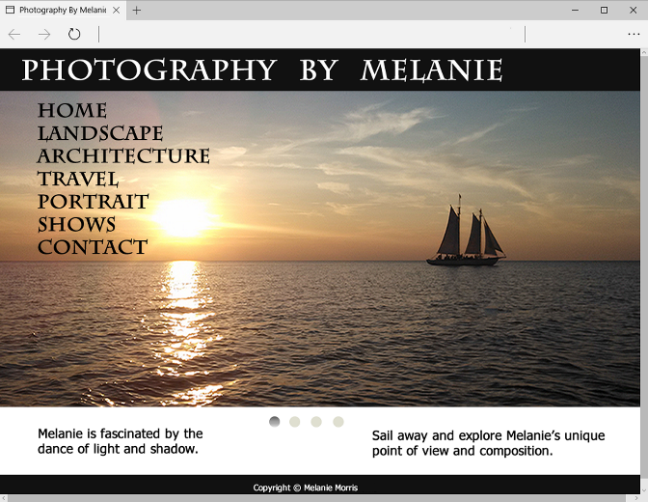
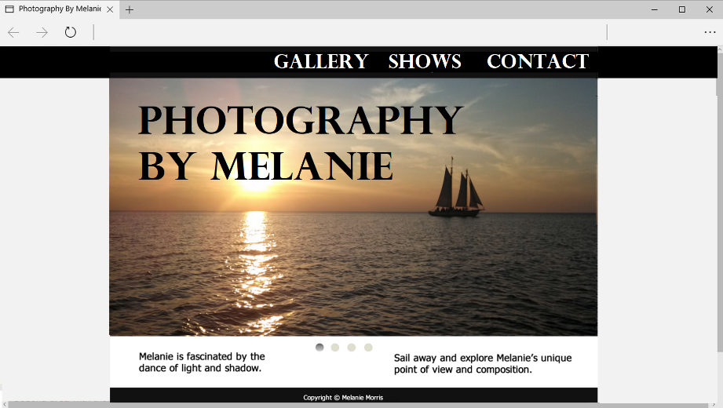
Page Layout Design Techniques (2 of 2)
Figure 5.39
Figure 5.40
Fluid Layout
AKA “liquid” design
Expands to fill the browser at all resolutions.
Fluid Layout Adaptation:
Full width top bar
Other age content typically centered with side margins

Slide 51
Flat Web Design
A minimalistic design style with a focus on simplicity, blocks of color, empty space between design elements, hero images, long shadows, buttons with transparent backgrounds, and use of typography.
Figure 5.27

Slide 52
Single Page Website
“One Page Website” Contains one very long page (a single HTML file) with a clearly defined navigation area, usually at the top of the page. This navigation takes you to specific areas on the page. (More in Chapter 6)

Slide 53
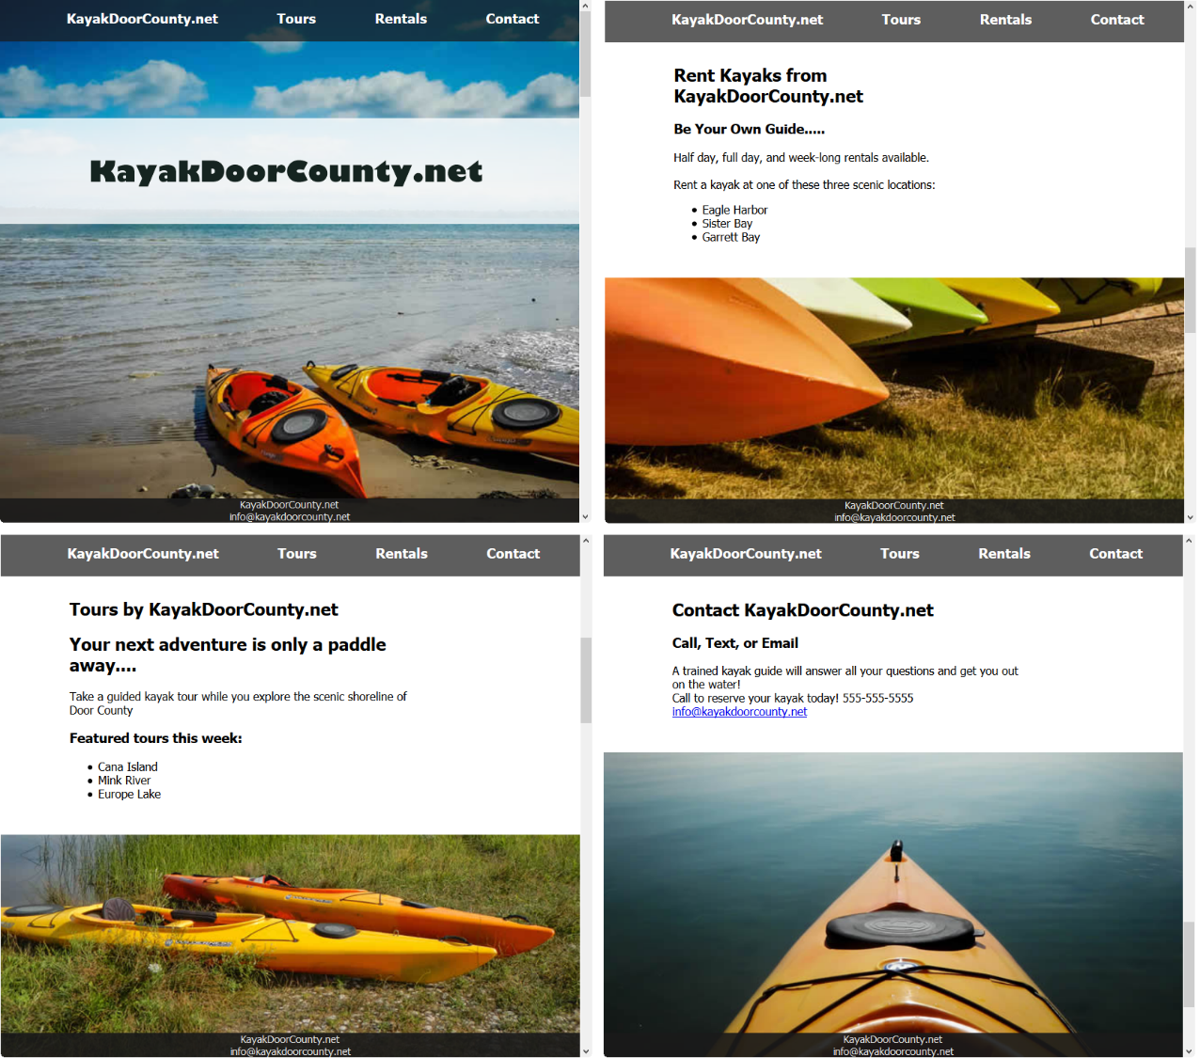
Figure 6.53 Using the background-attachment property

Slide 54
Mobile Design Quick Checklist
Small screen size
Bandwidth issues
Single-column layout
Maximize contrast
Optimize images for mobile display
Descriptive alternate text for images
Avoid display of non-essential content

Slide 55

Figure 5.42 Mobile display.

Slide 56
Progressive Enhancement (1 of 2)
Design your website so it displays well in mobile devices
Design your website so that it is usable in older browsers
Add enhancements with CSS and/or HTML5 to take advantage of the capabilities of modern browsers.

Slide 57


Progressive Enhancement (2 of 2)
Figure 5.41
Figure 5.42

Slide 58
Responsive Web Design
Ethan Marcotte, noted web developer https://www.alistapart.com/articles/responsive-web-design
Progressively enhancing a web page for different viewing contexts (such as smartphones and tablets) through the use of coding techniques, including flexible layouts and media queries.
Examples: https://www.mediaqueri.es

Slide 59
Web Design Best Practices Checklist
https://terrymorris.net/bestpractices
Page Layout
Browser Compatibility
Navigation
Color and Graphics
Multimedia
Content Presentation
Functionality
Accessibility

Slide 60
Checkpoint (1 of 2)
View the home page of your school. Use the Best Practices Checklist (Table 5.1) to evaluate the page. Describe the results.
View your favorite web site (or a URL provided by your instructor).
Maximize and resize the browser window.
Decide whether the site uses fixed or fluid design.
Adjust the screen resolution on your monitor (Start > Control Panel > Display > Settings) to a different resolution than you normally use.
Does the site look similar or very different?
List two recommendations for improving the design of the site.
3. List three best practices of using graphics on web pages. View the home page of your school. Describe the use of graphic design best practices on this page.

Slide 61
Checkpoint (2 of 2)
List three best practices of using graphics on web pages. View the home page of your school. Describe the use of graphic design best practices on this page.

Slide 62
Summary
This chapter introduced you to best practices of web design.
The choices you make in the use of color, graphics, and text should be based on your particular target audience.

